Slide 1
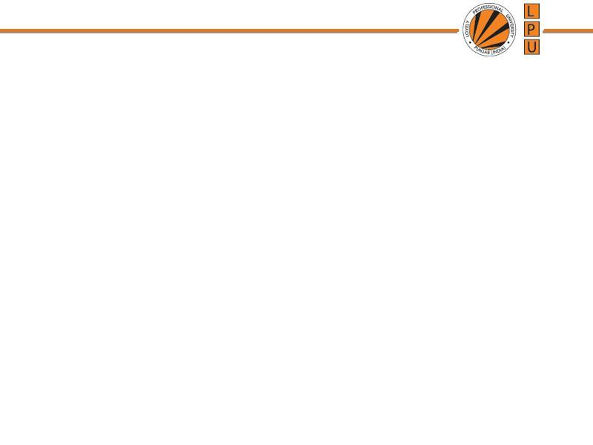
Chapter : Process Synchronization

Slide 2
Synchronization Hardware
Hardware Solution to C.S.
Many systems provide hardware support for critical section code
Uni-processors – could disable interrupts
  Currently running code would execute without preemption
Modern machines provide special atomic hardware instructions
    Atomic = non-interruptable
  Either test memory word and set value
  Or swap contents of two memory words

Slide 3
Hardware Solution to C.S.
1. Interrupt Disabling
Process leaves control of CPU when it is interrupted.
Solution is:
  To have each process disable all interrupts just after entering to the critical section.
  Re-enable interrupts after leaving critical section

Slide 4
Hardware Solution to C.S.
Interrupt Disabling
Repeat
Disable interrupts
C.S
Enable interrupts
Remainder section

Slide 5
Hardware Solution to C.S.
2. Hardware instructions
Machines provide instructions that can read, modify and store memory word
Common inst. are:
  Test and Set
  This inst. Provides action of testing a variable and set its value
  It executes atomically
  Test and Set instructions operates on single Boolean variable.

Slide 6
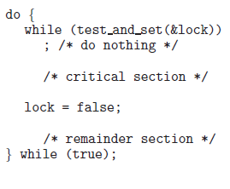
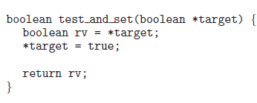
Hardware Solution to C.S.
//initially lock is FALSE

Slide 7
Swap Instruction
Definition:
void Swap (boolean a, boolean b)
{
boolean temp = a;
a = b;
b = temp:
}

Slide 8
Hardware Solution to C.S. Using Swap
Shared data : lock initialized to false
Boolean:lock;
do{
flag=true;
while(flag)
swap(lock,flag);
C.S.
lock=false;
Remainder Section
} While(True);
swap(lock,flag)
{
  temp = lock;
  lock=flag;
  flag=temp;
  }

Slide 9
Semaphore
Synchronization tool that maintains concurrency using variables
Semaphore S is a integer variable which can take positive values including 0. It is accessed from 2 operations only.
Operations On Semaphore:
wait() and signal()
1. Wait Operation is also known as P() which means to test
2. Signal Operation is also known as V() which means to increment
Entry to C.S. is controlled by wait()
Exit from C.S. is signaled by signal()

Slide 10
Semaphore
Can only be accessed via two indivisible (atomic) operations and S=1
For critical Section problem semaphore value is always 1
P(S) and V(S):
  wait (S) {
  while (S <= 0)
  do skip ; // no-op}
  S- -;
  C.S
  signal (S) {
  S++; }

Slide 11
Semaphore as General Synchronization Tool
Types of Semaphores:
Counting semaphore – when integer value can be any non-negative value
Binary semaphore – integer value can range only between 0 and 1
  Also known as mutex locks

Slide 12
Semaphore and Busy Waiting
Disadvantage of Semaphore: Busy Waiting
When a process is in C.S. and any other process that wants to enter C.S. loops continuously in entry section.
Wastes CPU cycles
Semaphore that implements busy waiting is known as: Spin Lock

Slide 13
Semaphore Implementation with no Busy waiting
With each semaphore there is an associated waiting queue. Each entry in a waiting queue has two data items:
  value (of type integer)
  pointer to next record in the list

Slide 14
Semaphore Implementation with no Busy waiting
Instead of waiting, a process blocks itself.
Two operations:
  block – place the process invoking the operation on the waiting queue.
  wakeup – remove one of processes in the waiting queue and place it in the ready queue.

Slide 15
Semaphore Implementation with no Busy waiting
Implementation of wait:
S=3
wait (S){
value--;
if (value < 0) {
add process P to waiting queue
block();
}
      C.S
      }

Slide 16
Semaphore Implementation with no Busy waiting
Implementation of signal:
Signal (S){
value++; //“value” has -ve value i.e -1 here
if (value <= 0) {
remove a process P from the waiting queue
wakeup(P); }
}

Slide 17
Deadlock and Starvation
Deadlock – two or more processes are waiting indefinitely for an event that can be caused by only one of the waiting processes
Starvation – indefinite blocking. A process may never be removed from the semaphore queue in which it is suspended.

Slide 18
Classical Problems of Synchronization
Bounded-Buffer Problem
Readers and Writers Problem
Dining-Philosophers Problem

Slide 19
Bounded-Buffer Problem
N buffers, each can hold one item
Semaphore mutex initialized to the value 1
Semaphore full initialized to the value 0
Semaphore empty initialized to the value N.
mutex= 1
full= 0
empty= N

Slide 20
Bounded Buffer Problem (Cont.)
The structure of the producer process
while (true) {
// produce an item
wait (empty);
wait (mutex);
// add the item to the buffer
signal (mutex);
signal (full);
}

Slide 21
Bounded Buffer Problem (Cont.)
The structure of the consumer process
while (true) {
wait (full);
wait (mutex); // mutex=1
// remove an item from buffer
signal (mutex); // mutex=0
signal (empty);
// consume the removed item
}

Slide 22
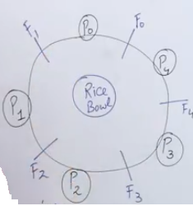
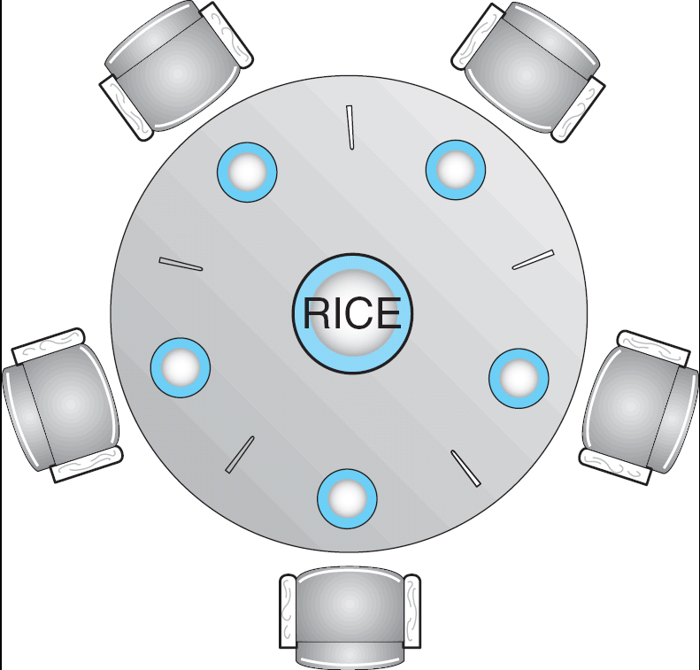
Dining-Philosophers Problem
Shared data
  Bowl of rice (data set)
  Semaphore chopstick [5] initialized to 1

Slide 23
Dining-Philosophers Problem (Cont.)
The structure of Philosopher i:
    While (true) {
    wait ( chopstick[i] );
    wait ( chopstick[ (i + 1) % 5] ); // =1
    // eat
    signal ( chopstick[i] );
    signal (chopstick[ (i + 1) % 5] );
    // think
    }

Slide 24
Problems with Semaphores
Incorrect use of semaphore operations:
  signal (mutex) …. wait (mutex)
  wait (mutex) … wait (mutex)
  Omitting of wait (mutex) or signal (mutex) (or both)

Slide 25
Monitors
A way to encapsulate the Critical Section by making class around the critical section and allowing only one process to be active in that class at one time.
Only one process may be active within the monitor at a time
  Name of Monitor
  Initialization Code Section
  Procedure to request the Critical Data
  Procedure to release the Critical Data
    monitor monitor-name
    {
    // shared variable declarations
    procedure P1 (…) { …. }
    …
    procedure Pn (…) {……}
    Initialization code ( ….) { … }
    …
    }
    }

Slide 26
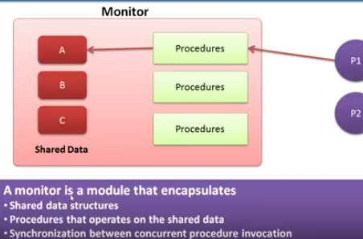
Monitors

Slide 27

Schematic view of a Monitor
Only one process at a time can be in monitor

Slide 28
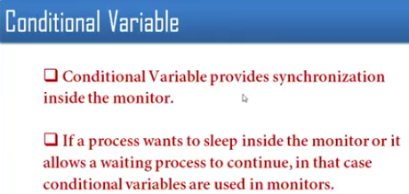
Condition Variables

Slide 29
Condition Variables
condition x, y;
Two operations on a condition variable:
  x.wait () – a process that invokes the operation is suspended until x.signal()
  x.signal () – resumes one of processes (if any) that invoked x.wait ()
  There could be different conditions for which a process could be waiting
  Let a process made the request to C.S. but no critical data is available, So we would not go back to check all the conditions again to run the request, As we have checked some conditions so processes will be lined up for excess to C.S.

Slide 30

Monitor with Condition Variables

Slide 31
MCQ Questions
Which process can be affected by other processes executing in the system?
a) cooperating process
b) child process
c) parent process
d) init process

Slide 32
MCQ Questions
1 a

Slide 33
MCQ Questions
When several processes access the same data concurrently and the outcome of the execution depends on the particular order in which the access takes place, is called
a) dynamic condition
b) race condition
c) essential condition
d) critical condition

Slide 34
MCQ Questions
2 b

Slide 35
MCQ Questions
If a process is executing in its critical section, then no other processes can be executing in their critical section. This condition is called
a) mutual exclusion
b) critical exclusion
c) synchronous exclusion
d) asynchronous exclusion

Slide 36
MCQ Questions
3 a

Slide 37
MCQ Questions
Which one of the following is a synchronization tool?
a) thread
b) pipe
c) semaphore
d) socket

Slide 38
MCQ Questions
4 c

Slide 39
MCQ Questions
A semaphore is a shared integer variable
a) that can not drop below zero
b) that can not be more than zero
c) that can not drop below one
d) that can not be more than one

Slide 40
MCQ Questions
5 a

Slide 41
MCQ Questions
Mutual exclusion can be provided by the
a) mutex locks
b) binary semaphores
c) both mutex locks and binary semaphores
d) none of the mentioned

Slide 42
MCQ Questions
6 c
Explanation: Binary Semaphores are known as mutex locks.

Slide 43
MCQ Questions
When high priority task is indirectly preempted by medium priority task effectively inverting the relative priority of the two tasks, the scenario is called
a) priority inversion
b) priority removal
c) priority exchange
d) priority modification

Slide 44
MCQ Questions
7 a

Slide 45
MCQ Questions
8. Process synchronization can be done on
a) hardware level
b) software level
c) both hardware and software level
d) none of the mentioned

Slide 46
MCQ Questions
8 c

Slide 47
MCQ Questions
9. A monitor is a module that encapsulates
a) shared data structures
b) procedures that operate on shared data structure
c) synchronization between concurrent procedure invocation
d) all of the mentioned

Slide 48
MCQ Questions
9 d

Slide 49
MCQ Questions
To enable a process to wait within the monitor,
a) a condition variable must be declared as condition
b) condition variables must be used as boolean objects
c) semaphore must be used
d) all of the mentioned

Slide 50
MCQ Questions
10 a

Slide 51
End of Chapter

